Slide 1
LabVIEW Session 4. Miscellaneous topics
Prepared by:
Alexander De Los Reyes
10 April 2019

Slide 2
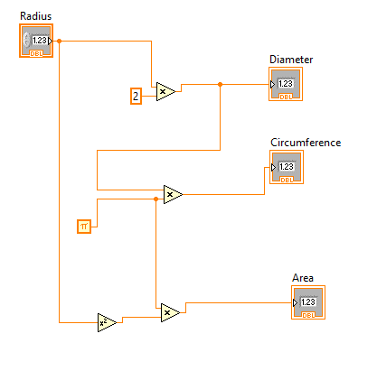
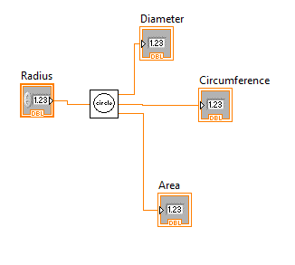

Creating a sub vi
Example: Measurements of a circle
Notes:
You also can drag a graphic from anywhere in your file system and drop it in the upper right corner of the front panel or block diagram. LabVIEW converts the graphic to a 32x32 pixel icon.

Slide 3
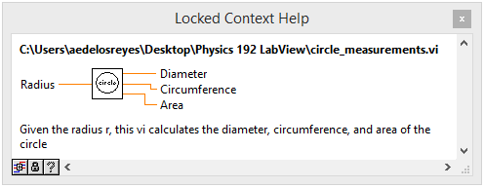
Documenting a vi

Slide 4
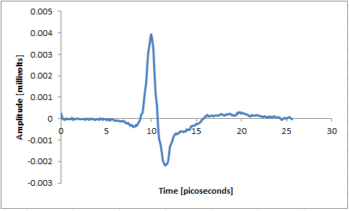
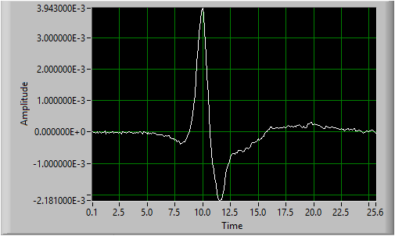
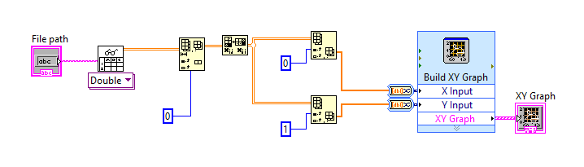
Reading spreadsheet file/ Plotting/ Arrays

Slide 5
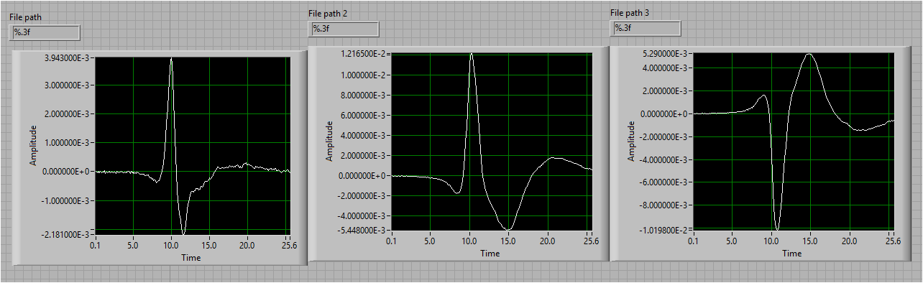
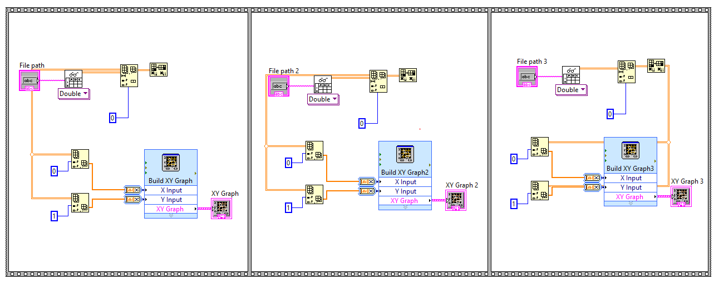
Flat and Stacked Sequence

Slide 6
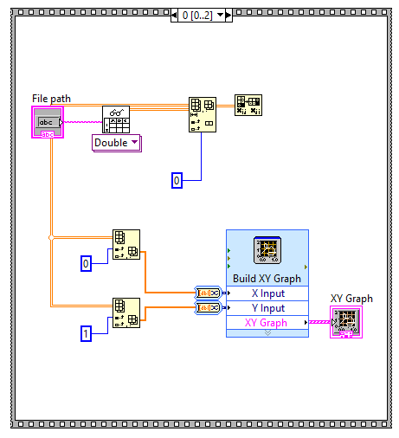
Flat and Stacked Sequence

